Slide 1
Lesson 9-1 Developing an Experiment
CS 185C: Introduction to Numerical Ocean Modeling

Slide 2
Project Summary
Key Points:
Develop a model to answer a science question
Model components should be provided on Github and the model should be reproducible (by Mike)
Model results should be visualized and answer the science question
Presentations will take place in week 16 (5/6 and 5/8)
Model and documentation are due on the day of the final
May 14at 1:15PM )

Slide 3
Why run an experiment?
Identify a process
What causes this to happen?
Replicate observations
Why do we see this feature in our measurements?
Quantify one or more processes
How does this process impact the system?
Extrapolate or interpolate in space
How will this process change in years to come or in different circumstances?

Slide 4
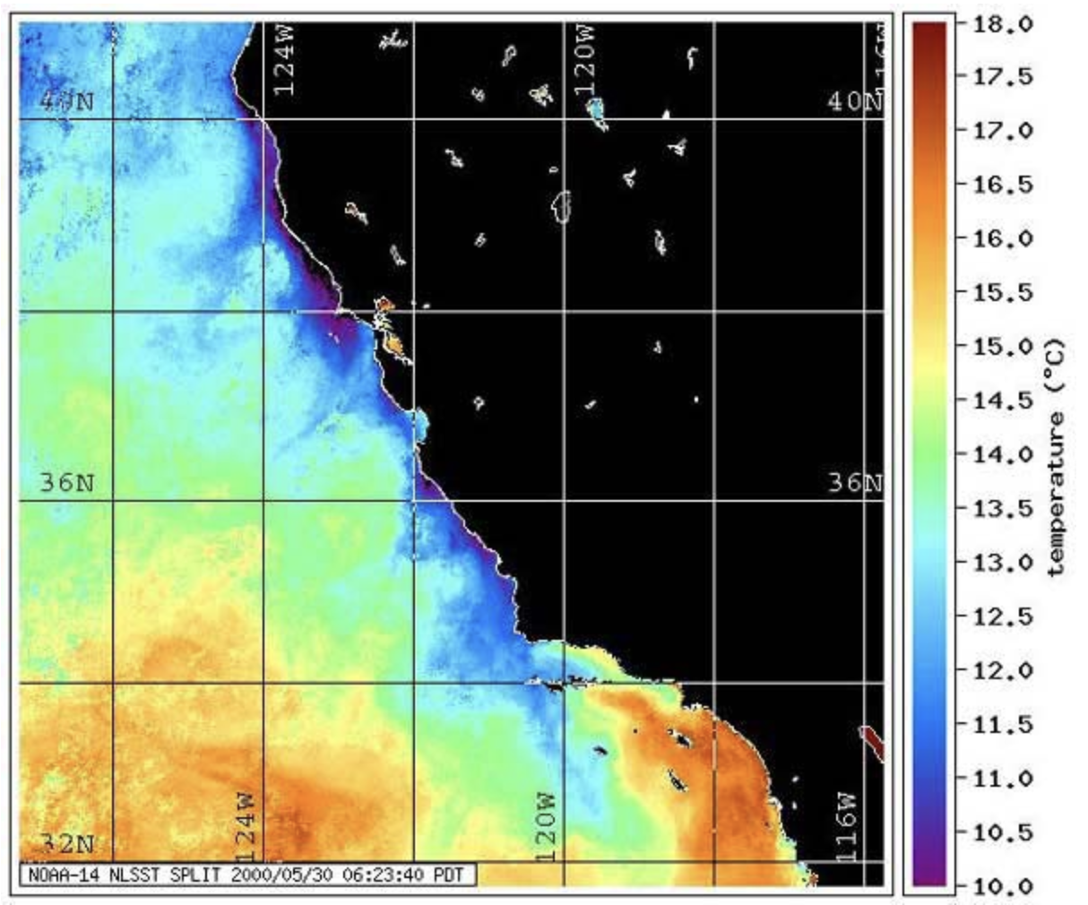
Mike’s Project California Upwelling
Question:
If the winds did not blow in CA, how would the water temperature change?

Slide 5
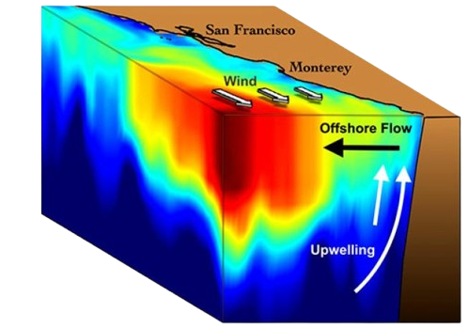
Approach
External Forcing Conditions (e.g. wind)
Make a regional domain
Use ECCO (coarse model) to provide pertinent information
You can follow along with my example to help in the construction of your model
Boundary Conditions (Temperature, Salinity, Currents)
Initial Conditions (Temperature, Salinity, Currents)

Slide 6
Model Grid
The model grid is the first piece of information you’ll need to construct your model
The initial fields, implementation, and performance of your model will all depend on the model grid you choose
This week, we’ll focus on constructing the model grids for our experiments

